Slide 1

welcome
TO OUR PRESENTATION

Slide 2
PROJECT DONE BY
SQUAD---
PORTFOLIO-
CS21B1061 – CH SHIVA KASHYAP
HOMEPAGE-
CS21B2023 – L DEVANSH
RESUME-
CS21B2029 – K VENKATESH
CS21B2041 – R JEEVAN KUMAR

Slide 3
Website link-
https://databaseteam-github-io-q813.vercel.app/

Slide 4
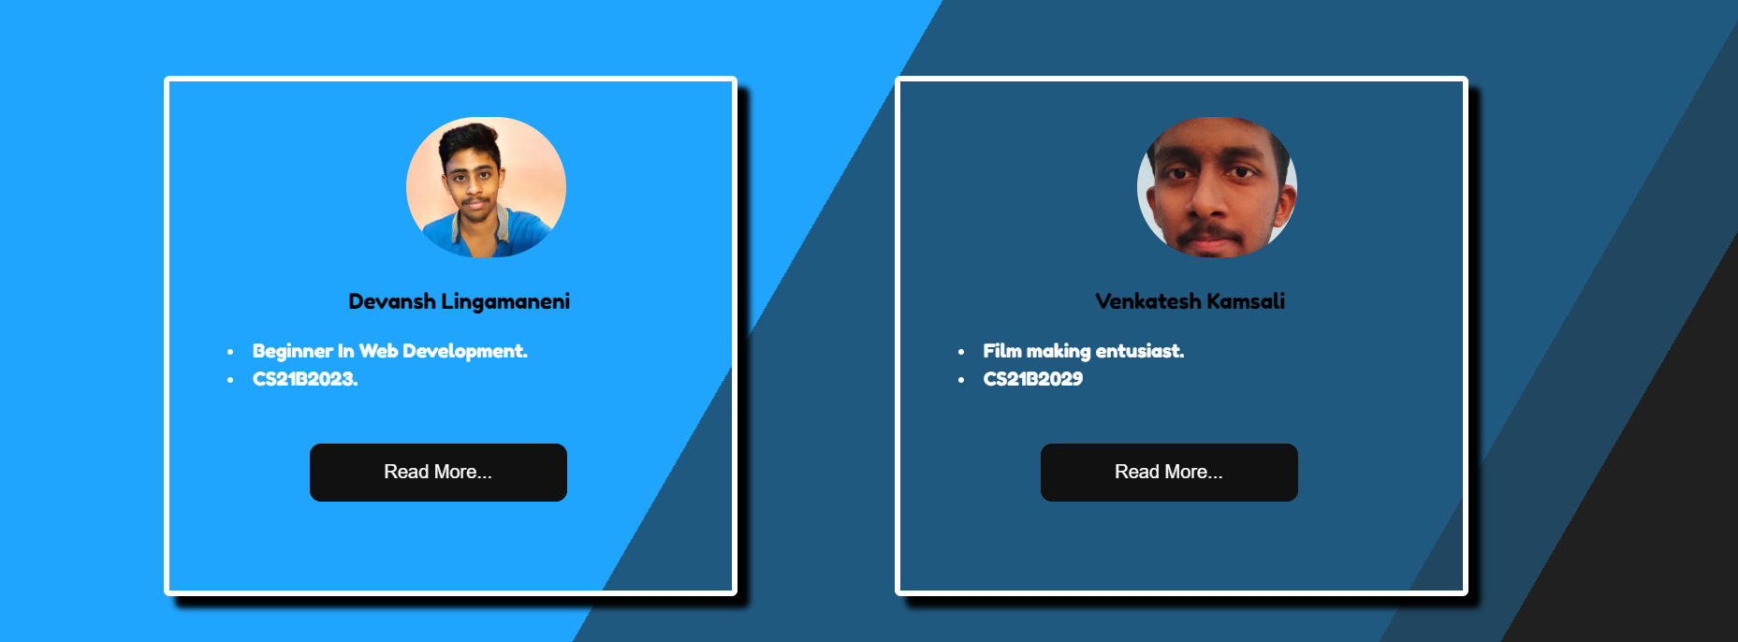
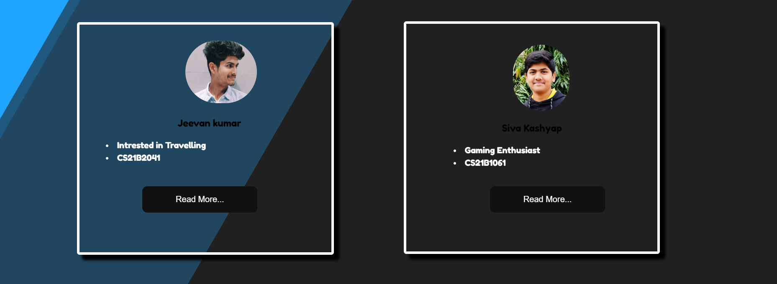
HOME PAGE

Slide 5
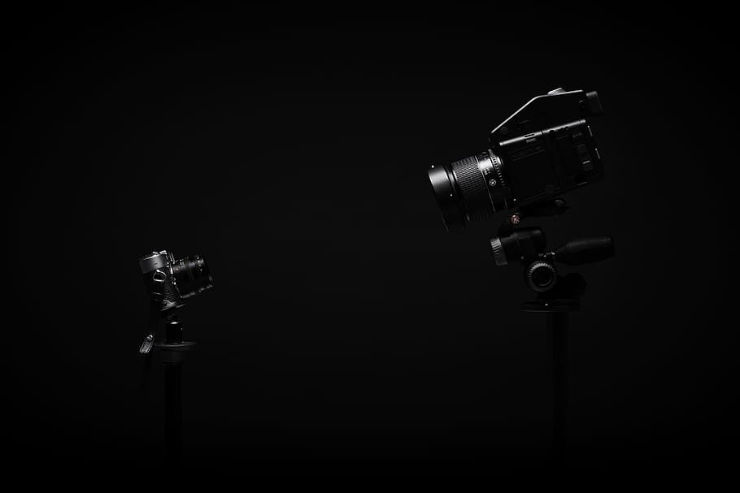
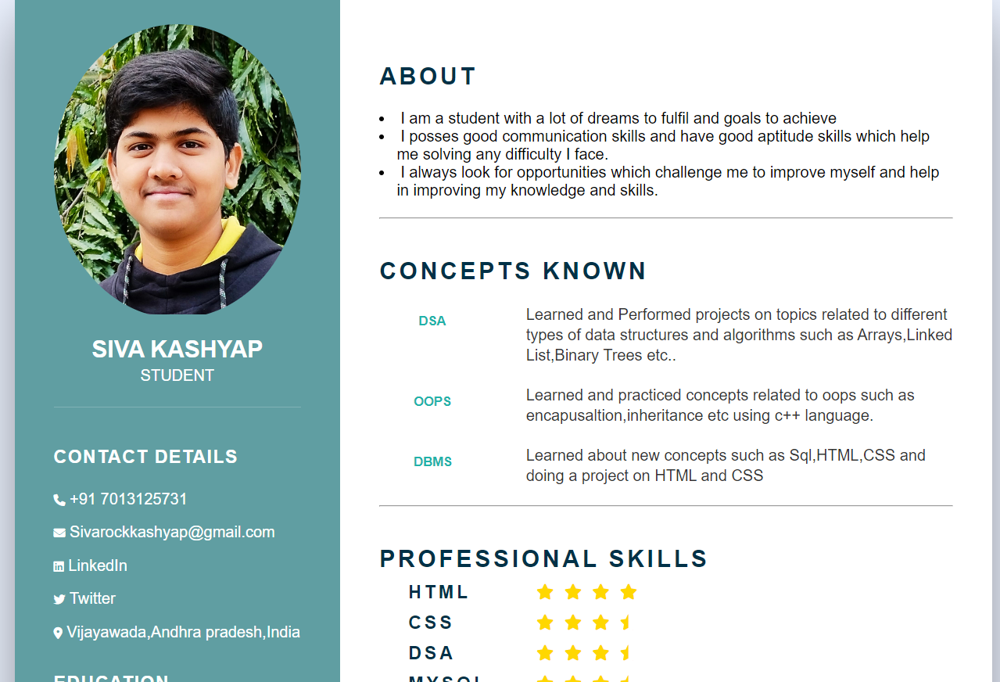
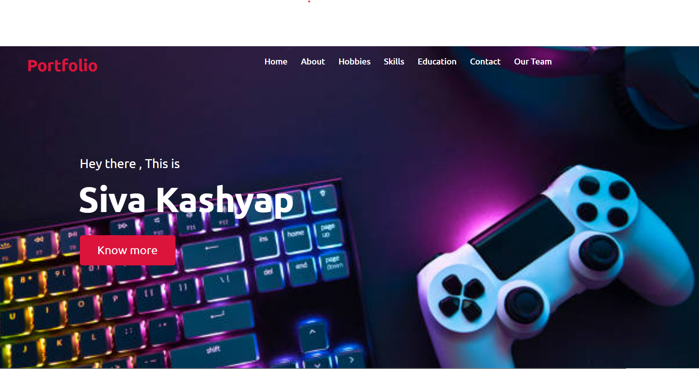
CH Shiva Kashyap
USED TECHNOLOGIES-
HTML , CSS bootstrap and font awesome
Difficulty in padding text and images to perfect positions.

Slide 6

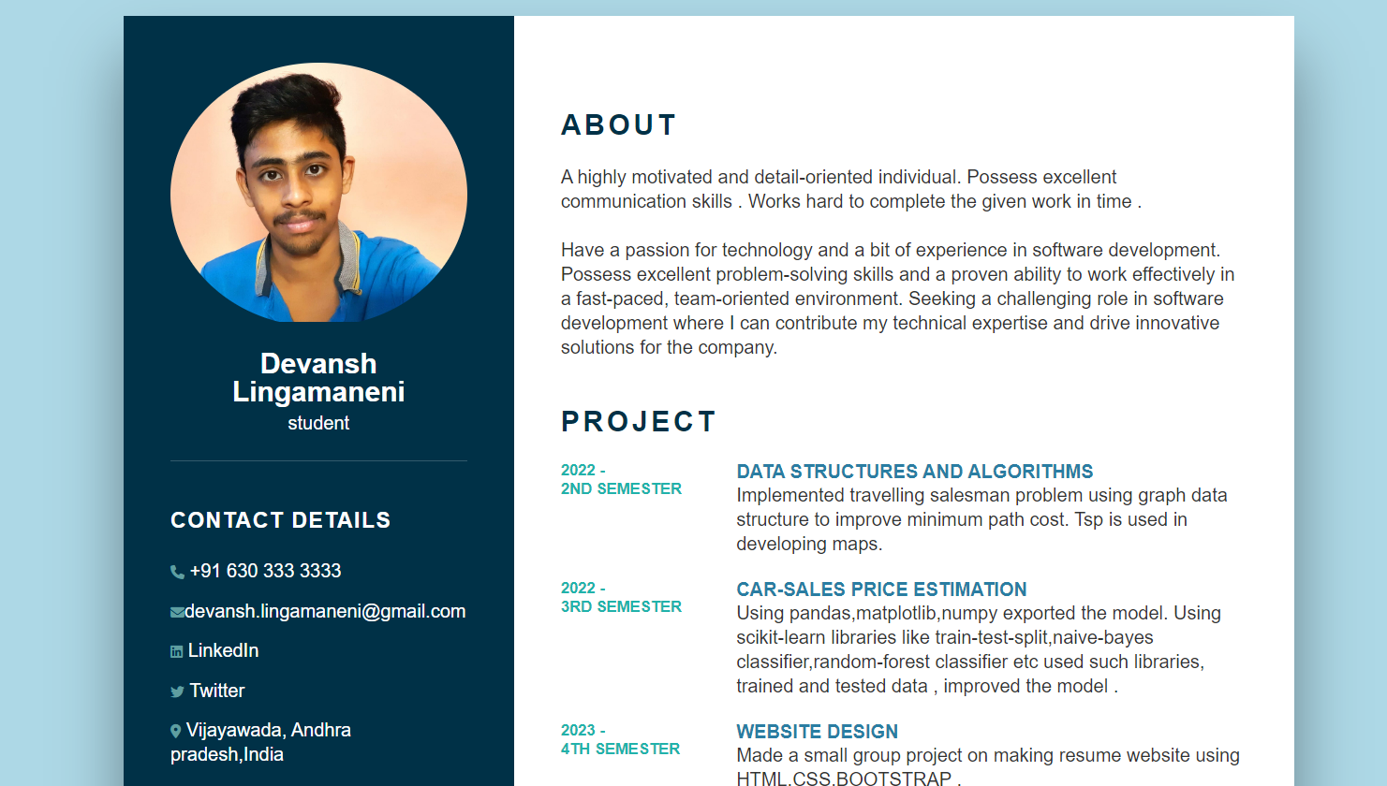
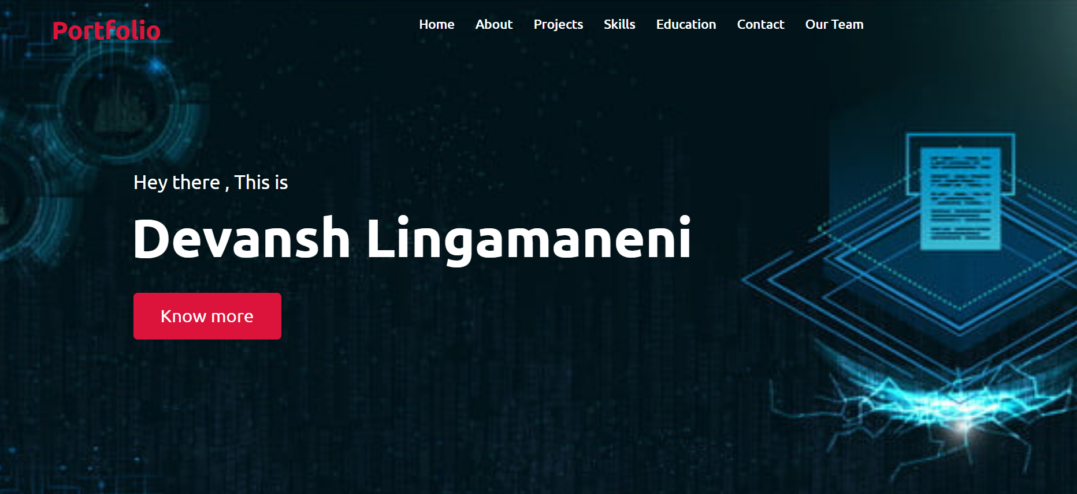
2) L Devansh
TECHNOLOGIES USED-
HTML, CSS, bootstrap , fontawesome and animation.
Difficulty while creating cards without using bootstrap.
Button 3d effect

Slide 7

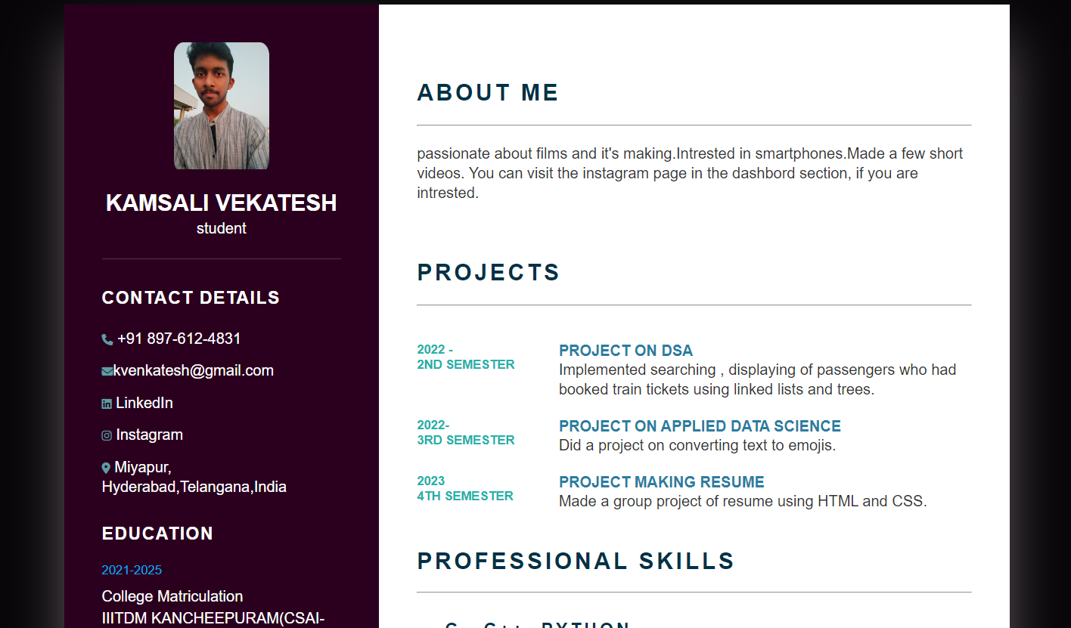
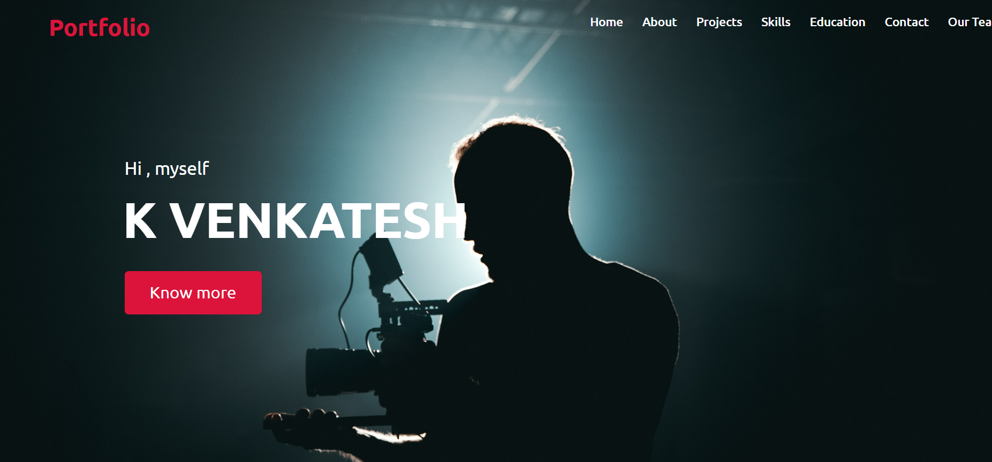
3) K venkatesh
TECHNOLOGIES USED-
HTML, CSS and font awesome
Didn’t got the exact icons for hobbies section.
Arrangement of lines in desired areas

Slide 8

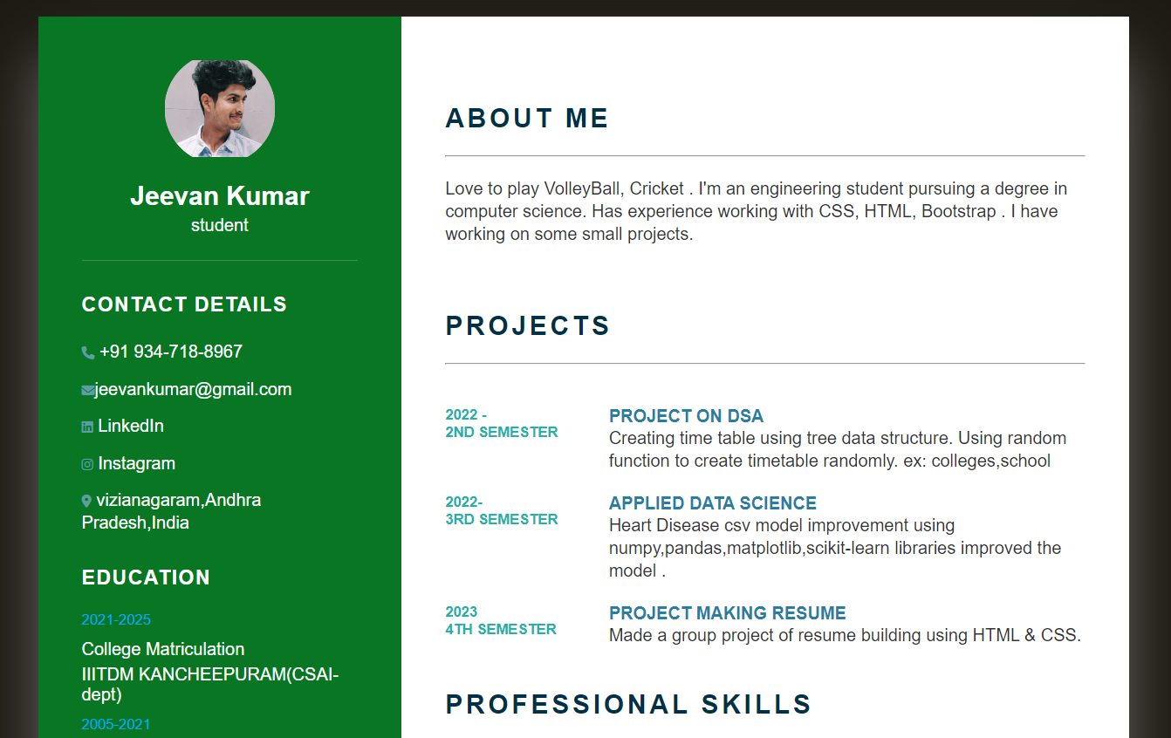
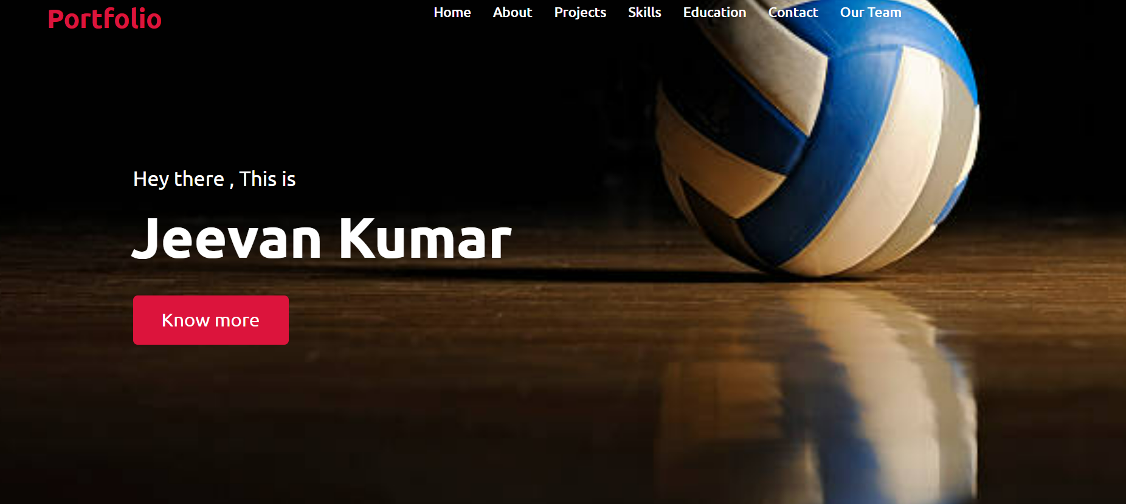
4) R Jeevan Kumar
TECHNOLOGIES USED-
HTML , CSS and font awesome
Arrangement of statements in the desired areas took some time
Difficulty in finding font awesome icons and aligining them in sequence.

Slide 9

Thanks for watching

